Slide 1
New Hampshire Liberty Alliance
Bill Review Training
Notes:
Welcome to the New Hampshire Liberty Alliance Bill Review Training
The purpose of this training is to get you started with the information you'll need to participate as a bill reviewer.

Slide 2
Topics
Why we review Bills
Resources
Reviewing a bill
Questions
Sample Bill Reviews
Notes:
Topics we are going to cover include
Why we do bill reviews
Some resources that you may find useful while doing reviews
The Mechanics of actually reviewing a bill
What to do when you are reviewing a bill and have questions
And finally, we’ll go over a few sample bills to demonstrate the bill review process.

Slide 3
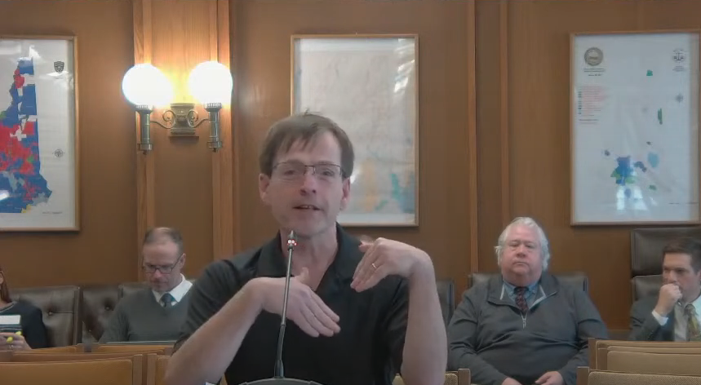
Why
Early alert to activists on high impact bills
Provide talking points for committee testimony
Change the course of the legislation
  Kill bad bills or minimize their harm
  Support good bills
Notes:
Before we get into *how* we review a bill, it is important to understand some of the reasons *why* we review bills in the first place.
In a typical legislative year, there are more than 1000 bills that are considered by the state legislature. The sheer quantity means that activists can't always find the bills they want to act on alone. Having many eyes reviewing bills and helping to find the impactful ones means we can get activists and friendly legislators engaged early.
Liberty activists and legislators will often go speak in front of committees in support of or against a specific piece of legislation. Having another set of eyes looking at the bills and coming up with the top level talking points can be great starting point for someone writing committee testimony.
As a bill works its way through the house and senate, content from the bill review helps us to direct our energy to stop bad bills or support good bills. Even in cases where we are unable to fully stop a bad bill, getting involved early may allow friendly legislators to submit amendments that minimize the harm of legislation if we are unable to stop it.

Slide 4
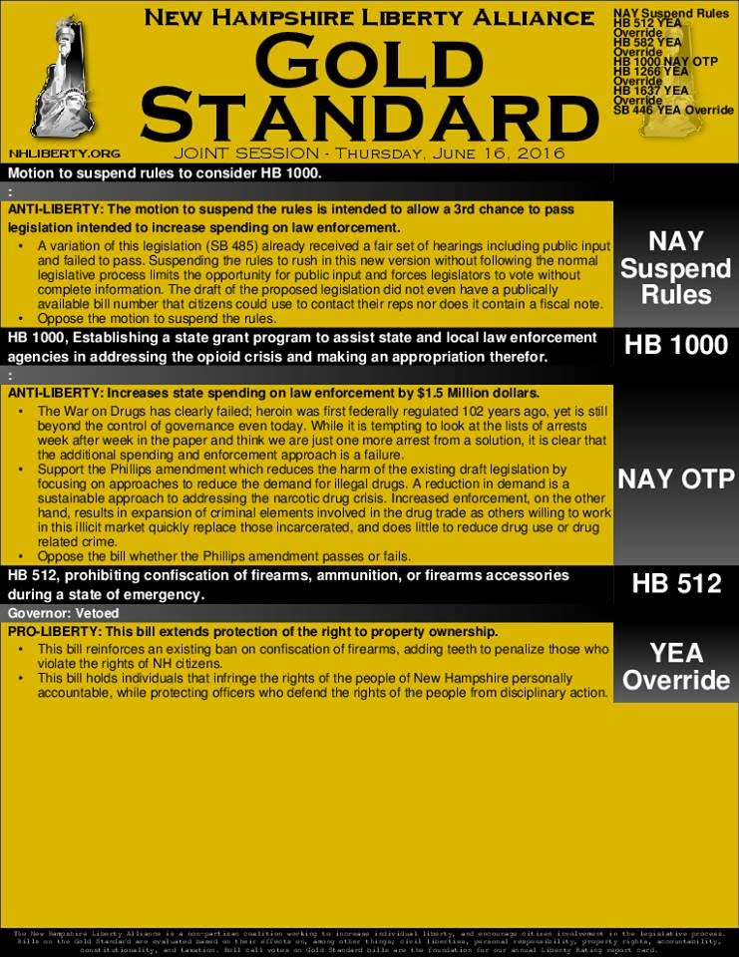
Why
Input to the Gold Standard
  Legislators don’t always read the bills.
  The Gold Standard provides voting recommendations and rationale
  A quality bill review substantially contributes to a quality Gold Standard
Notes:
Bill review content also helps the NHLA to draft and release the Gold Standard. This is a weekly publication that we provide to legislators to help them decide how to vote. Even in NH, there are legislators who don't have the time to fully read every bill that come up for a vote. Some legislators rely on guidance from party leadership and outside source to help them understand the legislation.
Click
The Gold Standard provides a liberty perspective on voting recommendations and bill summaries.
Click
Having a quality bill review (particularly for high impact bills) helps the NHLA to have a high quality gold standard as there is generally less than a week from the point when the legislative calendar is released until we have to send the gold standard to the printer.

Slide 5

Why
Allows us to ‘score’ legislators with a year-end liberty rating
Supports Incumbent Endorsement
Increases transparency and helps voters hold legislators accountable.
Notes:
Bill reviews and the Gold standards that follow from them, allow the NHLA to create an annual Legislative Score Card called the Liberty Rating.
Click
This in turn helps us to determine which incumbents running for re-election should be endorsed and supported by activists.

Slide 6
Resources
Members Facebook Group – nhliberty.org/facebook
NH Constitution - www.nh.gov/glance/constitution.htm
NH Revised Statutes Online (RSA) - Current Law - gencourt.state.nh.us/rsa/html/indexes/default.html
NH Dem Platform – nhdp.org/who-we-are/our-platform
NH GOP Platform – nh.gop/platform
NH Libertarian Platform – www.lpnh.org/about/platform
Notes:
Some bills can be reviewed without making reference to any external resources however there are several resources you should be aware of that you may find helpful
For a limited number of issues, the NHLA has general guidance on how we will approach the issues. This does not mean that our position on any particular bill is a foregone conclusion but being familiar with the positions can be helpful. We’ll go into a little more detail about each of these in a moment.
Click
There are a number of issues on which the NHLA does not generally take a direct position since there are competing liberty principles.
Click
Prior gold standards (and for that matter prior bill reviews) can be helpful as it is not uncommon for very similar legislation to be entered year after year. While I would not generally recommend searching for every topic before reviewing every bill, over time, you may come to recognize topics and in these cases, reviewing prior content can save time.
Click
Finally, there is an NHLA Bill Reviewers Facebook group where you can ask questions about specific legislation or the bill review system itself.
Click
Next are resources on the state website. All bill reviewers should read the NH constitution from beginning to end at least once. For a non-trivial number of reviews, I open and refer to the constitution to help determine the constitutionality of proposed legislation. While arguments based solely on conflicts with the state constitution may not be broadly effective they should still be included when a bill conflicts with the constitution.
Click
The existing laws are something that you'll need to become comfortable reading. Many bills revise existing language and so often understanding the existing text is key to understanding if a particular bill is pro liberty or not - If the existing law called for a 100% tax rate, then a bill that propose to change that rate to 50% (as horrendous as it sounds) would still be an improvement
Finally, an additional source can be the state party platforms - we'll talk a little more about those in a few minutes.

Slide 7
Resources - NHLA Positions
Occupational Licensing – Protectionist barrier to entry into the workforce
Drug Policy – Self-Ownership / Prohibition is a failure
Education – Families should control - not government
Government Transparency – Mitigates corruption and waste
Death Penalty – Against
Notes:
While this training is not a substitute for reading the NHLA positions page, we'll quickly cover each of the major topics just so have a general sense of where the NHLA stands on some key issues
The Death Penalty used to be among our “Do Not Touch” issues but after a survey of membership, the NHLA board voted to remove this issue from Do Not touch and take the position that NH would be well served to discontinue the option of using the death penalty.
Click
The NHLA believes in the fundamental right of self-ownership and as a result it is not the proper role of the state to decide what individuals may eat, drink or smoke. In addition, prohibition continues to be a proven failure at curbing abuse and increases the power of criminal cartels.
Click
We believe that families, not the state, are in the best position to control the education of their children.
Click
People have the right to know how their money is being spent. Transparency, even though it may have modest costs, is required to keep corruption and waste in check.

Slide 8
Resources - NHLA Positions
Gun Rights – Pro Article 2a - No permission slips
Localism – Prefer Local decision making but not at the expense of individual liberty.
Taxes – Reduce taxes. Rely on voluntary funding of services.
Social Programs – Government programs promote dependency. Voluntary charity fosters more individualized care.
Bill reviewers are strongly encouraged to read the Gold Standard each week to understand our positions.
Notes:
The NHLA supports the right to keep and bear arms and believes that this right as recognized in Article 2-a of the NH constitution is not contingent on a government issued permission slip.
Click
We believe that government is most accountable and accessible when it is most local. Therefore, we believe that local control is generally preferable to state or national mandates.
We do believe that there is a higher principle however – the principle of individual liberty. For this reason, we support state laws that prevent local governments from abridging the personal or property rights of individuals.
Click
Taxes compel people to fund programs which may be counterproductive or even unethical. We believe most or all goods and services can and should be funded on the basis of voluntary consent. We support efforts to reduce taxes, and put money back under the control of the people who earned it.
Click
Government programs create dependency and often do far more harm than good. We believe voluntary charities are the ideal way to address the needs of those who require assistance.
Click
.... Once again, please real the NHLA positions page for detailed rationale about each of these positions

Slide 9
Resources – Prior Gold Standards
Spend some time reading some prior issues to
get a sense of our positions, language, etc.
  nhliberty.org/category/gold-standard/
Many bills or concepts are recycled year-over-year. We maintain a ‘spreadsheet’ form of prior year gold standards.
  nhliberty.org/legacy_gs
Notes:
Prior gold standards may be helpful to you while reviewing a bill. The NHLA website has a search feature that allows you to limit searches to prior gold standards.
Click
Click
Here you can see a search for civil asset and see that this term has appeared several times in the gold standard. Always read and understand the current bill and be on the lookout for the need to change the argument to match the updated legislation

Slide 10
Exercise
Are the following bills likely pro or anti-liberty based on summary?
This bill allows cities and towns the option to add a local surcharge to existing rooms & meals tax if approved by voters?
This bill establishes licensure and inspection practice for body art establishments.
This bill prohibits prospective employers from asking an applicant about salary history.
This bill allows parents to “opt-out” of non-academic surveys for their children in public schools.
This bill establishes a commission to study the licensure of individuals who forage for wild mushrooms for sale to others.
The bill requires pharmacists and pharmacies to use a new red warning label for any prescription containing opiates.

Slide 11
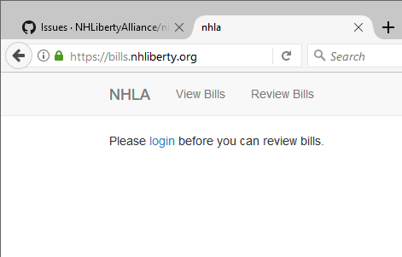
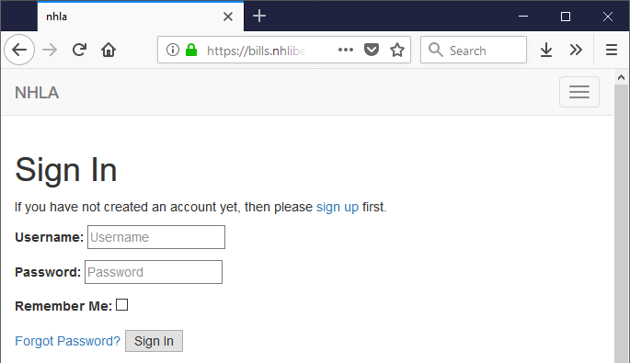
Reviewing Bills – Login
After completing this training, email billreview@nhliberty.org to get bill review privileges.
Go to bills.nhliberty.org to start
Username is the same as your nhliberty.org website password.
When in doubt, use the ‘forgot’ password to reset/establish your password
If you can login but don’t see the ability to enter reviews, please message billreview@nhliberty.org

Slide 12
Finding Bills to Review
Review bills that have public hearings, floor votes or other pending action coming up
Follow a committee/topic that is important to you
Follow a committee/topic that others are not following
Review a simple bill
In short, find an approach that works for you.
Notes:
There are usually more than 1,000 bills that we need to review and in that regard, any bill review that you complete adds value to the process however there are some guideline that you can use to help you figure out where to start.
Click
The most important thing you can do is to look at the list of unreviewed bills and review bills that have some action coming up on them in the statehouse.
Click
Bills, particularly as they apply to the current law can be complicated. Some reviewers choose to focus on a bills going through a particular committee or related to a topic about which they are passionate. Remaining focused on a topic that you care about is a great way to avoid burnout and to ensure that you have the deep knowledge that might be helpful on the more complicated bills.
Click
You may find that certain topics are already fairly well covered (for example, firearms related bills tend to have a lot of passionate followers) in which case you may start to see that certain topics are not well covered. If you are willing to dig into a topic like this (for example, insurance law) you could quickly become an expert.
Click
For your first few bills, the approach I recommend is to find a simple bill, regardless of topic and review it. Some bills have many pages of text or impact multiple complex areas of existing laws. Feel free to stay away from those as you get started.
Click
In the end, it is more important that you find a place to start that works for you and begin reviewing bills than almost anything else.
Click
Well, almost anything, remember we almost always need help with bills that have near term activity going on in the statehouse!

Slide 13
Various Bill Types Prefix/Suffix
Prefix (Suffix) | Definition | Typical Impacts | Has effect of Law | Example
HB/SB | House/Senate Bill | Low-High | Yes | New RSA banning picking of green apples
HCR/SCR | Concurrent Resolution | Low | No | NH house and senate urge congress to plant more apple trees
CACR | Constitutional Amendment Concurrent Resolution | Medium-High | ~Yes | Add new Part First – Bill of Rights - Art 40 “All persons have the right to grow apples for themselves, their families and friends.”
HR/SR | Resolution | Low | No | NH house or senate affirm that an apple a day keeps the Doctor away.
HJR/SJR | Joint Resolution | Low-High | Yes | Allocate $50 million dollars in 2018 to fund the Apple Growers account effective immediately.
(-FN) | Fiscal Note | - | - | Indicates the bill has a Fiscal Note – an estimate of spending/revenue increase/decrease added to the bill
Notes:
http://www.gencourt.state.nh.us/house/abouthouse/houserules.htm
There is one more called a House Address. I don’t see in that list but I do see

Slide 14
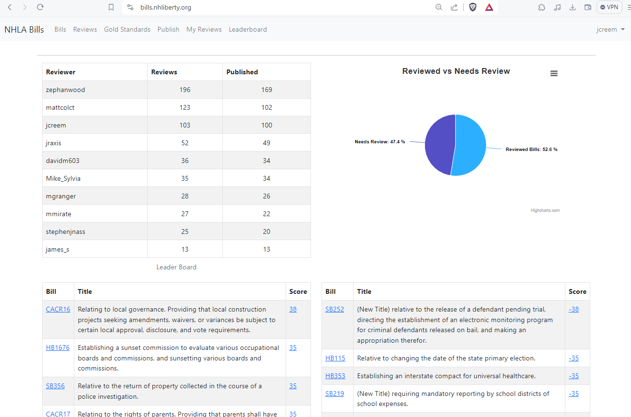
Finding Bills to Review
Notes:
When you first log in, you’ll be presented with a dashboard that shows you statistics about the state of bills in the system. To start reviewing, click the “Review” tab at the top of the page.

Slide 15
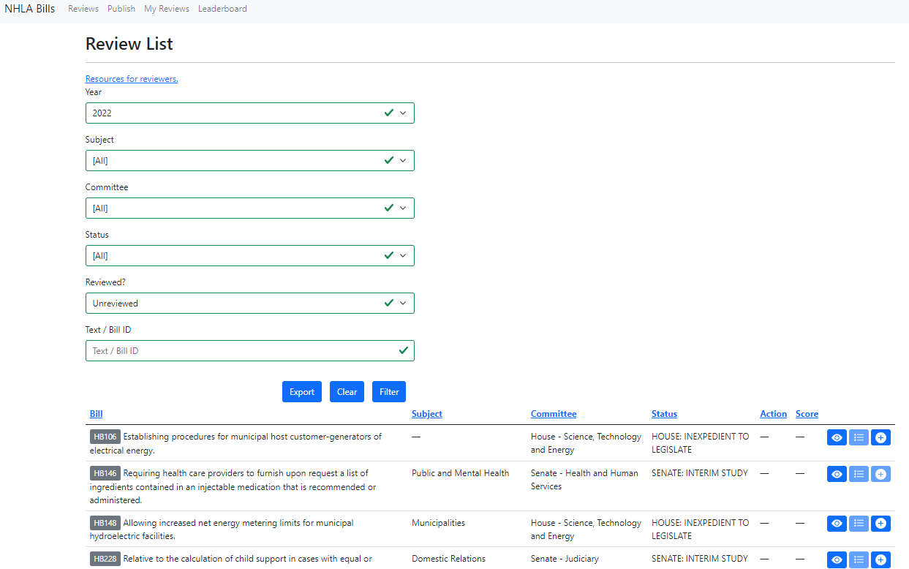
Finding Bills to Review
Notes:
This will bring up a filter panel where you can filter an all bills to help you find one you want to review. If you are looking to do a review, you’d search for bulls with either a status of “Unreviewed” or “Need’s Review”

Slide 16
Finding Bills to Review - Review Status
Unreviewed – Just as it sounds. The bill has not been reviewed.
Stale Review – new text – Bill was previously reviewed, but its content has changed. Review may need to be updated.
Reviewed – Bill was reviewed, and underlying bill has not changed
  You can still submit another review (more details, differing opinion, etc.)
Focus on ‘unreviewed’ first, needs re-review second.

Slide 17
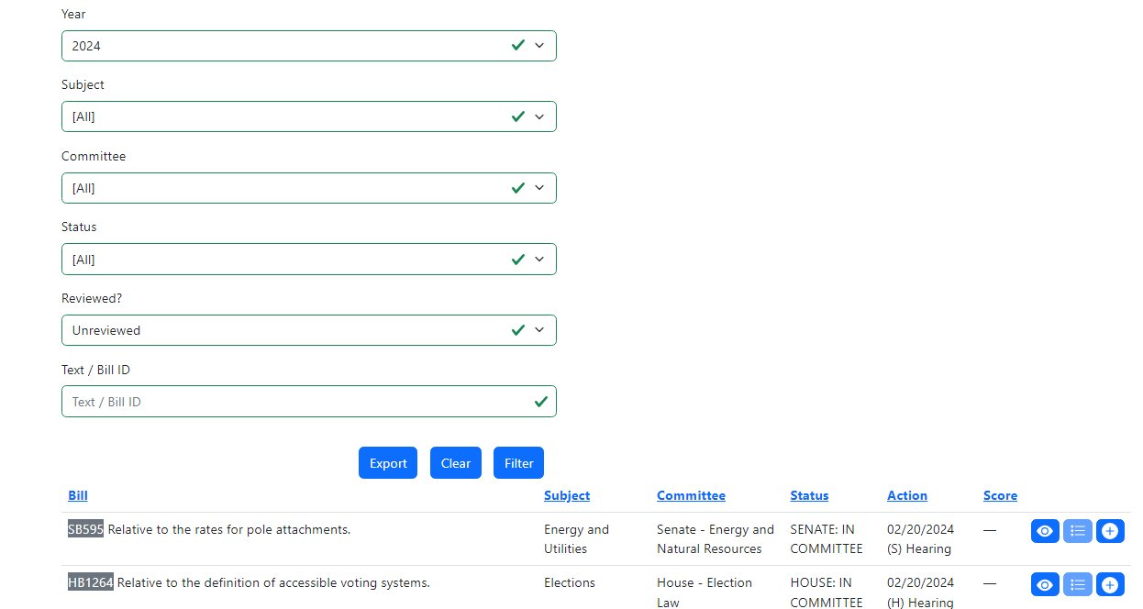
Finding Bills to Review
Give priority to bills that have upcoming action
Click on column title to sort
Click on the bill number to get to the bill details

Slide 18
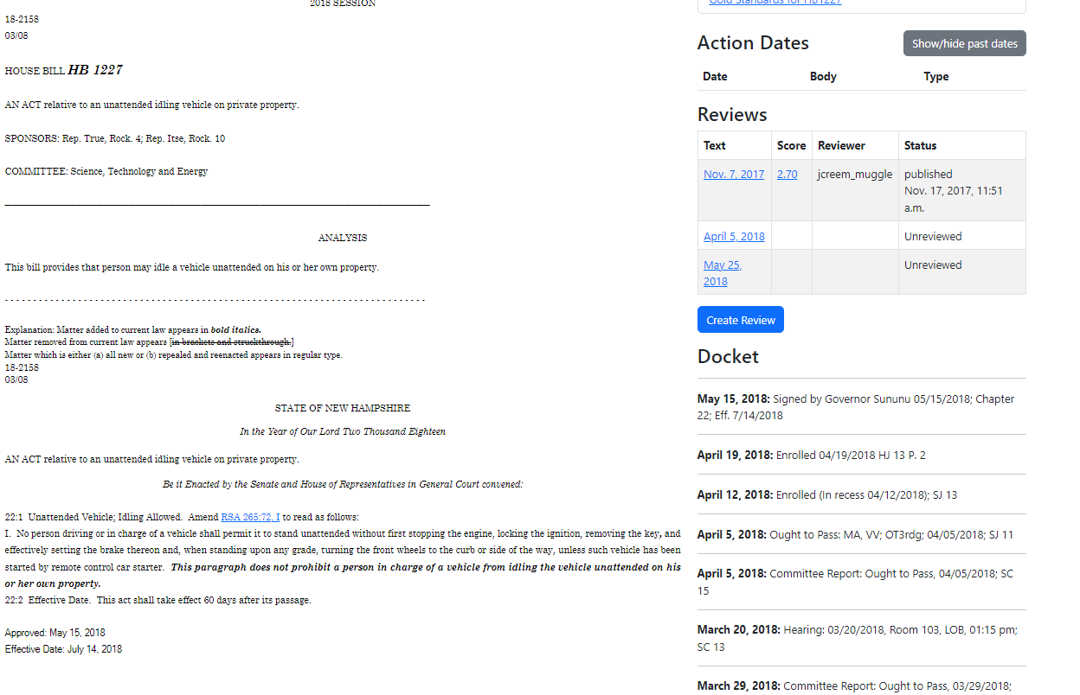
Finding Bills to Review – Bill Text
Title of the bill and list of sponsor(s)
Let’s you look at the different versions of the text of the bill over time.
What legislative services thinks the bill does.
Not generally biased one way or another but also
not always complete/accurate
Actual text of the bill

Slide 19
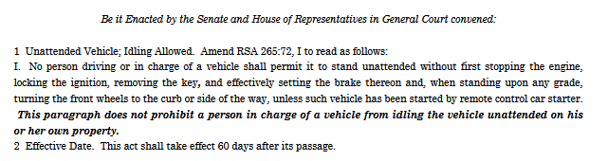
Finding Bills to Review – Check the Bill Text

Slide 20
Finding Bills to Review – Do the Review
Click on “Create Review” to start the review

Slide 21
HB1227
AN ACT relative to an unattended idling vehicle on private property.
Be it Enacted by the Senate and House of Representatives in General Court convened:
22:1 Unattended Vehicle; Idling Allowed. Amend RSA 265:72, I to read as follows:
I. No person driving or in charge of a vehicle shall permit it to stand unattended without first stopping the engine, locking the ignition, removing the key, and effectively setting the brake thereon and, when standing upon any grade, turning the front wheels to the curb or side of the way, unless such vehicle has been started by remote control car starter. This paragraph does not prohibit a person in charge of a vehicle from idling the vehicle unattended on his or her own property.
Explanation: Matter added to current law appears in bold italics.
Matter removed from current law appears [in brackets and struckthrough.]
Matter which is either (a) all new or (b) repealed and reenacted appears in regular type.

Slide 22
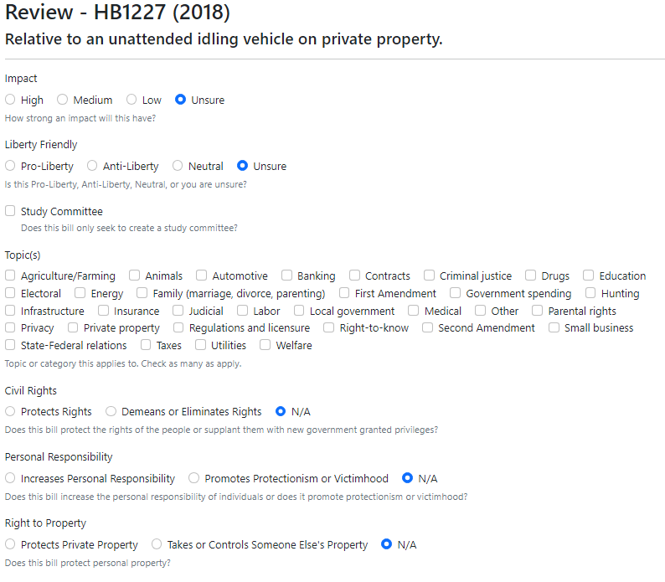
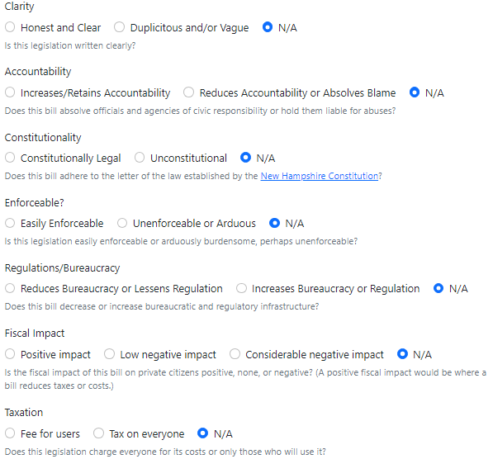
Reviewing a Bill
Notes:
Once

Slide 23
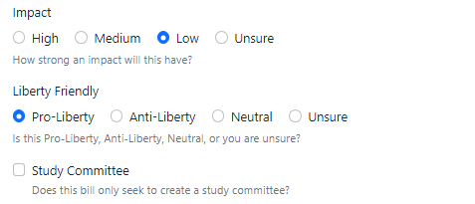
Reviewing a Bill – Liberty Friendly/Impact
We rate bills pro-liberty, anti-liberty, neutral
or unsure
  Sometimes this may be the last field you
  fill in after reading bill and doing other
  ratings.
Impact rating is High, Average or Low
  High – Impacts almost everyone in state, creates new state agency, spends ‘a lot’ of money, amends constitution, etc.
  Average – May have a big impact to a subset of the population or a smaller impact on a large subset
  Low – Names a bridge, resolution calling upon some other body to do something, trivial theft/spending etc.
+2
Study Committee
  Some bills only create legislative study committees to look into future legislation
  Almost always low impact even if topic is high impact.
  If bill is only a study committee, unless it has a forgone anti-liberty conclusion, mark it and move to the next bill.
NH spends about ~$7.7* billion per year (23/24 biennium).
Therefore, $1 million of ‘one time’ spending is not “High Impact”.
$ <= $2 million Low, $ <= $30 million Average, > $30 million High – subject to refinement, recurrence and topic
Notes:
Next are a few very simple fields. We rate bills as Pro-Liberty, Anti-Liberty Neutral or Unsure.
Click
Next is the impact with possible ratings of High, Average and Low. A high impact bill would be one that impacts a majority of the people in the state, or perhaps creates a new state agency.
Click
Average impact is a bill that impacts only a small subset of the population – even though that impact may be large. Or it could be a bill that impacts a broader population in a small way.
Click
Low impact bills tend to be things that don’t make significant changes to existing law or take actions that have no lasting consequences on liberty.
Click
Some bills do not actually create any lasting legislation but rather, they form committees to research topics associated with future legislation. If the bill you are reviewing only forms or modifies a study committee, then check the box, mark the bill as low impact and move on to the next bill review. Don’t invest further effort into the bill.

Slide 24
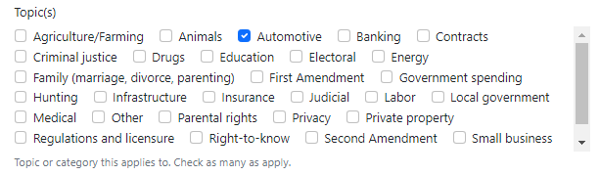
Reviewing a Bill - Topics
Don’t struggle here. Take a shot, select a few topics and move on.
Topic selection may be helpful for searches or alerts, but you should not be spending more than 1 minute on this box.
Notes:
The first thing you are asked to fill in is a selection box where you can indicate the topic or topics that this bill addresses.
Click
You can use the control key and potentially click multiple topics.
Click
While this is useful data, don’t spend too much time on this. Find something close, click it and move on.

Slide 25
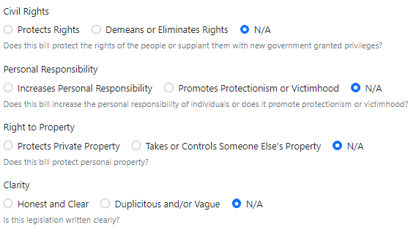
Reviewing a Bill – Radio Buttons
Quickly progress through each question making your choice
It is OK for a bill to remain N/A on some factors
These factors combine to influence the liberty score for the bill
You don’t have to agree with the bill to rate it honest and clear
Notes:
The next area of the bill review is a series of buttons where you will indicate some whether the bill has certain attributes or not. For instance, the first set are related to civil rights, personal responsibility and the Right to property. These factors along with the pro/anti liberty friendly rating are used to convert the bill into a numeric score that is used to help activists recognize the bills that we should be paying attention to. You don’t have to get these exactly right. Read each question and make your choice. In some cases, a bill may be N/A for one or more of these factors.

Slide 26
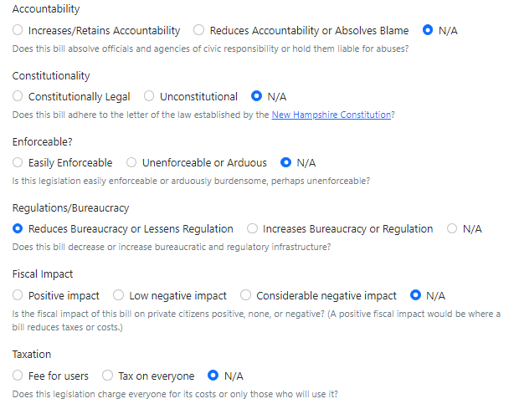
Reviewing a Bill – Radio Buttons
If you take the position that the bill is unconstitutional, please add a constitutional note.
A low negative Fiscal Impact might spend a small amount of money only for a single year
Larger amounts and/or recurring amounts of spending push into “considerable negative impact” (~$5M in one year)
Resist urge to overweight. 100 bills all rated high does not help us focus on the highest impacts to liberty.
+3
Notes:
Next, we rate the bill on Clarity, accountability, constitutionality and enforceability.
Click
If you take the position that the bill is unconstitutional, you should add a note (later in the review) making reference to the section of the constitution that is being violated.

Slide 27
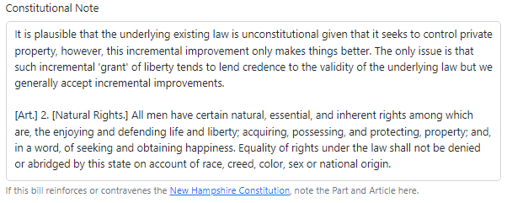
Reviewing a Bill – Constitutional Note
If you’ve marked a bill unconstitutional (or constitutional for that matter) add a note backing up the position with a reference to NH constitutional text and a rationale.
Even if you are not sure, a reference to the relevant constitutional section can be helpful.
Notes:
If you’ve marked a bill unconstitutional – or even to a lesser extent if you’ve marked it constitutional, fill in the constitutional note with a reference to the constitution and a rationale as to how constitution applies.
Click
You can still add a note here even if you marked the constitutional question as N/A. If you are not sure how to interpret the relevant section but you still have found text that might apply, you can still add it here.

Slide 28
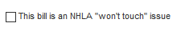
Reviewing a Bill – Won’t Touch
If you recognize the bill topic as a ‘Won’t Touch’ issue then check this box
This is intended to be checked only in cases when the bill strikes directly at the heart of a Won’t Touch issue.
Currently, bills dealing directly with Abortion are the only official won’t touch issues

Slide 29
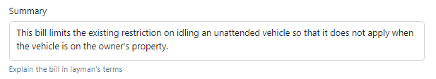
Reviewing a Bill - Summary
You can keep it short – one to two sentences. Longer is fine but
bottom line up front so people scanning through data can quickly understand the bill
.
In some cases, you may find the “Analysis” that legislative services puts on the bill helpful, and it can be used verbatim – but this is not always the case!
Notes:
The next field is the bill summary.
Click
It is usually filled in by default and often the default summary is fine as is. If you think it can be clarified, feel free to edit it.
Click
Don’t feel compelled to change it, particularly for neutral or very low impact bills.
Click
But on high impact bills, you may want to change it from generic state language such as “Relative to alimony’ to something a little more specific like “Automatically reduces alimony payments in cases where there is a tangible reduction in income”.
Click
If it is changed, try to keep it to one or two sentences.

Slide 30
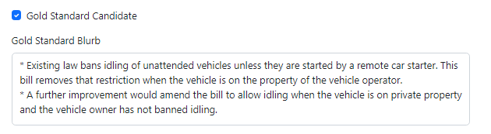
Reviewing a Bill – Gold Standard Blurb
If you think the bill is important enough for the Gold Standard, check the Gold Standard Candidate box
Either way, you can enter text in the “Blurb” box.
Limit yourself to 2-5 bullets. References to external sources are acceptable (and encouraged!)
If reviewing a low impact neutral bill, feel free to leave it blank
If you think the bill is important, please take a shot at some bullets. Blank Gold Standard blurbs on
medium/high impact bills are somewhat counter-productive.
Notes:
The final section of the bill review is made up largely of free form text boxes. You don’t have to put text in all of them. One of the easier fields is the “won’t touch’ checkbox. If you recognize this issue as an NHLA won’t touch issue, please check the box. It is ok to check this even if you are not 100% sure if it applies.
Click
Next, is the candidate Gold Standard blurb. Don’t feel like you have to get this language exactly right but this box is where you would attempt to put in 2-5 bullets supporting the position that you believe the NHLA should take if this bill appears in the Gold Standard. If you’ve rated the bill as Neutral then it probably does not make sense to spend any time coming up with bullets.
Click
In the anti—liberty talking points, you’d try to write some bullets that you think the opposition might have for this bill. So, if we expect that the opposition will agree with an anti-liberty bill, try to put in a few bullets describing why you think they might take that position. Conversely, if the opposition is going to oppose a pro-liberty bill, take a shot at why you think they might oppose it. You do not have to fill this in but it might be helpful for others who look at this review to develop their own bill testimony to research and provide counter-points to the potential opposition.
Click
Check this box if you think this bill belongs on the gold standard. Don’t struggle to make this decision. Make a guess and move on. The Gold Standard research team will make the final determination but knowing what the original reviewer thought may help prioritize their efforts.
Click
Finally we have the Pro-Liberty talking Points box. In general, at this point I would recommend ignoring this box. The original bill review form did not have the Gold Standard Blurb box and this is largely obsoleted by the addition of that field. However, if you feel that there are additional talking points that you would like raised in testimony or other activism, feel free to add them here.

Slide 31
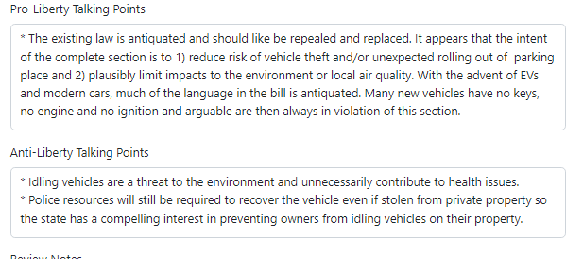
Reviewing a Bill – Talking Points
Pro-Liberty Talking points – What are some other things people on ‘our side’ should raise when discussing the bill
Anti-Liberty Talking points – What will the anti-liberty crowd say about the bill
These are not critical. Feel free to leave them blank but if you have thoughts or arguments that don’t seem like
Gold Standard worthy points that you want to share, put them here.
Pro-liberty talking points would be a great place to fill in thoughts you might share if you were going to
testify at a committee hearing on the bill.

Slide 32
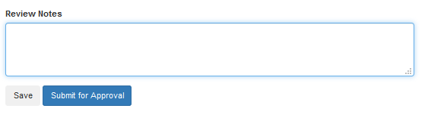
Reviewing a Bill – Wrapping it up
Add any additional notes, potentially additional research or information sources to back-up your claims
or explain your thinking.
Links to external sources are good. Notes about other times (years, bill number) similar legislation was tried
can be good.
When Done, hit “Submit for Approval” to share it with the team, or “Save” if you are still working and want to
come back to it later.

Slide 33
And Then What?
After you submit a review, it will need to be approved by a Master Reviewer before going live.
If you are a master reviewer, you can (and should) publish your own review
Master Reviewer status is provided when a reviewer has completed multiple reviews across a wide variety of topics that are near “Gold Standard” ready
We keep this list small for consistency – it does not mean we don’t value your input!

Slide 34
Questions during Reviews
What to do if you have questions while reviewing the bill:
  Post a question in the NHLA Facebook members group
    facebook.nhliberty.org
  Contact the sponsor directly – however only board members are authorized to ‘speak for’ the NHLA.
    gencourt.state.nh.us/house/members/memberlookup.aspx
  Email the committee
    gencourt.state.nh.us/house/committees/standingcommittees.aspx
  Skip it and move on to another bill
Notes:
If you are working a review and are not sure about some aspect of the bill or the bill review system there are several things you can do.
Click
The first thing you ca do is to post a question in the NHLA Bill review Facebook group. A more experienced reviewer or board member may be able to help you.
Click
If your question is more specific about the bill itself, you can reach out to the bill sponsor directly It is not unheard of for a reviewer to find an issue in the bill that even the bill sponsor has not recognized yet and by reaching out, you may be able to help the sponsor recognize an issue and correct problematic or confusing text.
Click
You may also want to consider reaching out to the committee that owns the bill. This may be a better choice than the sponsor if you believe that the sponsor is not friendly to the mission of the NHLA
Click
If you are stuck on a particular bill, feel free to quit the review and move on to the next bill.

Slide 35
Exercises – Part 2

Slide 36
Sample Bills – 2016 HB1169
AN ACT prohibiting bank fees for on-line accounts.
Be it Enacted by the Senate and House of Representatives in General Court convened:
1 New Paragraph; Bank Fees on On-Line Accounts. Amend RSA 382-A:4-401 by inserting after paragraph (d) the following new paragraph:
(e) A bank shall not charge a fee for an account accessible on-line.
2 Effective Date. This act shall take effect 60 days after its passage.
Notes:
This bill amends current law and prohibits fees for a bank account accessible on-line.

Slide 37
Sample Bills – 2016 HB1169
Topic:
Banking
Liberty Friendly:
Anti-Liberty
Impact:
Average
Civil Rights:
N/A
Personal Responsibility:
N/A
Right to Property:
Takes/Controls
Clarity:
N/A or Honest and Clear
Accountability:
N/A
Constitutionality:
N/A
Enforceability:
Unenforceable or Arduous
Regulations/Bureaucracy:
Increases Bureaucracy or Regulation
Fiscal Impact:
None
Taxation:
N/A
Notes:
Once again, we can go through each of the fields for the bill. You might want to pause and think about how you would rate each of these and then compare to the actual review as it was originally done. Remember that your ratings may not always match exactly and that can be ok.
Click -> Click -> Click until all of them show.

Slide 38
Sample Bills – 2016 HB1169
Anti-Liberty Talking Points: (Remember – this is ‘switching hats’ and talking from the perspective of our opponents)
Since banks require fewer tellers, they are gouging consumers by continuing to charge fees
Gold Standard Blurb:
Maintaining the security of online accessible accounts requires resources which this bill would deny - increasing the risk of data breach.
Nearly all accounts are accessible online resulting in this bill being a ban on all banking fees.
Many citizens utilize out of state banks for online banking and thus enforcement of this will be difficult or may reduce options provided to consumers.
Notes:
On this bill, the reviewer included an anti-liberty talking point. Recall this is something that the NHLA opposition might say about the bill.
Click
And these are the blurbs that were entered for the Gold Standard.

Slide 39
Sample Bills – 2019 HB485 - FN
AN ACT creating a one-day license for alcoholic beverages served at dinners hosted at farms.
Be it Enacted by the Senate and House of Representatives in General Court convened:
1 New Subparagraph; One Day License; Farm. Amend RSA 178:22, V by inserting after subparagraph (u) the following new subparagraph:
(w) One Day Licenses for Dinners at Farms Featuring New Hampshire Produced Beverages and Liquor.
(1) The commission may issue a limited license to any responsible individual representing an operational farm in New Hampshire. Such license shall authorize the licensee to sell, on premises approved by the commission, beverages and liquor on the approved premises.
(2) No license shall be issued under subparagraph (w)(1) unless the farm's representative obtains:
(A) Official approval of the chief of the local fire department as to the safety of the premises.
(B) Official approval of the local health department concerning sanitary accommodations.
(C) Official approval of the chief of police as to accessibility of the premises. Written statements from such officials shall accompany the application for the license. Such application shall be filed with the commission 15 days before the date on which the license is needed.
(3) No person under the age of 18 shall be allowed in those areas where liquor and beverages are served, unless accompanied by a parent, legal guardian, or adult spouse. The selectmen of the town in which such licenses are held may, at their discretion, assign police officers to the premises where liquor or beverages are being served.
(4) No license shall be issued under subparagraph (w)(1) for premises holding other licenses issued by the commission. The commission or its investigators may suspend without warning any license issued under subparagraph (w)(1) if, in their opinion, such sale of liquor and beverages is contrary to the public interest.

Slide 40
Sample Bills – 2019 HB485
Topic:
Regulations & licensure
Liberty Friendly:
Pro-Liberty
Impact:
Low
Civil Rights:
N/A
Personal Responsibility:
N/A
Right to Property:
N/A
Clarity:
N/A or Honest and Clear
Accountability:
N/A
Constitutionality:
N/A
Enforceability:
Unenforceable or Arduous or N/A
Regulations/Bureaucracy:
N/A
Fiscal Impact:
None
Taxation:
Fee for users or N/A
Notes:
Once again, we can go through each of the fields for the bill. You might want to pause and think about how you would rate each of these and then compare to the actual review as it was originally done. Remember that your ratings may not always match exactly and that can be ok.
Click -> Click -> Click until all of them show.

Slide 41
Sample Bills – 2019 HB485
Anti-Liberty Talking Points: (Remember – this is ‘switching hats’ and talking from the perspective of our opponents)
This bill would promote public intoxication and promote alcoholism.
Gold Standard Blurb: (though perhaps does not rise to level of Gold Standard)
Farmers and business operators should have the right to sell legal products from their premises if they believe that it is in their interest to do so. While the restrictions in this new license are still too burdensome, it represents a small step in the right direction by reducing the impact of existing state restrictions on commerce.
This bill would have a potential positive impact on farmers allowing them an alternate source of revenue and increasing the customer base for their products.
Notes:
On this bill, the reviewer included an anti-liberty talking point. Recall this is something that the NHLA opposition might say about the bill.
Click
And these are the blurbs that were entered for the Gold Standard.

Slide 42
Summary
Take the lessons from this training and start reviewing bills
  The best way to learn is to start reviewing
  The earlier it is in the legislative season, the easier it will be to find bills to review
  Don’t feel the need to write up clean blurbs for every bill. There is value even to the initial triage process
  Don’t be afraid to do some blurbs though either!
As you read a bill keep these simple thoughts in mind to help decide Pro/Anti/Neutral Liberty stance:
  Is it constitutional?
  Does it expand the size, cost, or power of government?
  Are there unintended consequences?
Thank you for being willing to defend Liberty in NH!
After completing this training, email billreview@nhliberty.org to get bill review privileges.
Notes:
And that is all there is to doing bill reviews. At this point, the best thing to do is to start doing reviews and learn as you go.
Click
Early in the legislative session, that is to say, January and February, there will be plenty of bills and many of them will be straightforward like the examples we’ve looked at today. As we get later in the season, you may find that many of the bills that remain are complex and it may take an hour or more to do the review. If you are starting at this point, don’t get discouraged.
Click
AS you review bills, don’t feel like you need to write up very clean gold standard blurbs for every bill. Some bills will never even make it to the gold standard and even just completing the initial triage and scoring the bill helps us.
Click
When you are doing reviews keep these thoughts in mind to help guide you in determining if a bill is pro or anti-liberty
Click
Is the bill constitutional?
Click
Does it expand the size, cost or power of government? If it does – it is anti-liberty even if you think the bill is a ‘good idea’
Click
Are there unintended consequences? At times, the secondary effects of a bill may be worse than the stated intent of the bill. Think these things through while evaluating the impacts.
Click
And that’s it! You are ready to start reviewing bills and defending Liberty in NH. If you’ve not reviewed bills before, you’ll need to email research@nhliberty.org to have bill review privileges added to your account. Thank you.

Slide 43
Backup

Slide 44
Resources - Platforms
State Party Platforms may contain useful content to help sway legislators
Generally, they should not be relied upon for ‘first principles’ liberty arguments
The NHLA is non-partisan and references to platforms should generally be informational.
Notes:
It may be useful to be familiarly with the state party platforms as some legislators may be more likely to respond to an argument that includes the fact that a particular bill is either aligned with or contrary to their own party's platform.
Click
A bill review argument should almost never rely on any party's platform to make a judgement about whether a particular bill is pro or anti liberty but it still can be an effective argument.
Click
Remember that the NHLA is non-partisan and as such you should feel free to reference any (or all) party’s platforms when researching a bill.

Slide 45
Platforms/Constitution/Resources
Democrats should also support this bill given the NHDP platform indicates:
“We recognize the collateral damage and harsh consequences of a conviction for the possession of marijuana and support decriminalization for possession of a small amount.”
Republicans should also support this bill given that the NH GOP platform indicates:
“Provide instructions for juries in criminal proceedings that they have the power both to judge the facts and the application of the law to those facts”
Do not ‘overthink’ the use of resources
Many bills can be evaluated purely on their own content and liberty principles
Notes:
If you recognize that a particular bill is aligned or against a party’s platform, here are some examples about how you might document a talking point in the review
Click
Indicate which party’s legislators should be aware of the supporting platform plank and where practical, quote a subset of the platform text.
Click
Platform references should always be considered secondary to more fundamental liberty arguments.

Slide 46
Sample Bills
HB1400 (2016) Defining suitable person for the purpose of obtaining a license to carry a firearm and extending the term of the license.
SB370 (2016) Establishing a committee to study real time threat notification systems to link schools with law enforcement when schools are under direct threat.
HB1169 (2016) Prohibiting bank fees for on-line accounts.
Notes:
Now that you’ve got the tools to theoretically review a bill, let’s look at a few example bills and walk through the review process on each of them. You may find it helpful to navigate to the training bills URL as we go through these slides so that you can read the text at your own pace.

Slide 47
Sample Bills – 2016 HB1400
AN ACT defining suitable person for the purpose of obtaining a license to carry a firearm and extending the term of the license.
Be it Enacted by the Senate and House of Representatives in General Court convened:
1 Pistols and Revolvers; License to Carry. Amend RSA 159:6, I(a)-(b) to read as follows:
(a) The selectmen of a town, the mayor or chief of police of a city or a full-time police officer designated by them respectively, the county sheriff for a resident of an unincorporated place, or the county sheriff if designated by the selectmen of a town that has no police chief, upon application of any resident of such town, city, or unincorporated place, or the director of state police, or some person designated by such director, upon application of a nonresident, shall issue a license to such applicant authorizing the applicant to carry a loaded pistol or revolver in this state for not less than [4] 5 years from the date of issue, if it appears that the applicant has good reason to fear injury to the applicant's person or property or has any proper purpose, [and that the applicant is a suitable person to be licensed] unless the applicant is prohibited by New Hampshire statute from both owning and possessing a firearm. Hunting, target shooting, or self-defense shall be considered a proper purpose. The license shall be valid for all allowable purposes regardless of the purpose for which it was originally issued.
(b) The license shall be in duplicate and shall bear the name, address, description, and signature of the licensee. The original shall be delivered to the licensee and the duplicate shall be preserved by the people issuing the same for [4] 5 years. When required, license renewal shall take place within the month of the [fourth] fifth anniversary of the license holder's date of birth following the date of issuance. The license shall be issued within 14 days after application, and, if such application is denied, the reason for such denial shall be stated in writing, the original of which such writing shall be delivered to the applicant, and a copy kept in the office of the person to whom the application was made. The fee for licenses issued to residents of the state shall be $10, which fee shall be for the use of the town or city granting said licenses; the fee for licenses granted to out-of-state residents shall be $100, which fee shall be for the use of the state. The director of state police is hereby authorized and directed to prepare forms for the licenses required under this chapter and forms for the application for such licenses and to supply the same to officials of the cities and towns authorized to issue the licenses. No other forms shall be used by officials of cities and towns. The cost of the forms shall be paid out of the fees received from nonresident licenses.
Notes:
You can see that HB1400 modifies existing RSA 159:6 and extends the duration of a pistol/revolver license from 4 year to 5. In addition, this bill would have removed the vague phrasing of ‘suitable person’ from the statute and replaced it with more objective text that indicated that the license should be issued as long as the person is not barred from owning and possessing a firearm.
This is clearly an improvement over existing law. A purist would, correctly, argue that such a license should not be required in the first place but the bill should be reviewed in the context of whether it improves the existing situation – not with respect to whether it aligns with an ideal standard.

Slide 48
Sample Bills – 2016 HB1400
Topic:
Second Amendment
Liberty Friendly:
Pro-Liberty
Impact:
Average
Civil Rights:
Protects Rights
Personal Responsibility:
N/A
Right to Property:
N/A
Clarity:
Honest and Clear
Reduces or Absolves Blame
N/A
Accountability:
Increases/Retains
Constitutionality:
Constitutionally Legal
Enforceability:
N/A
Regulations/Bureaucracy:
Reduces Bureaucracy or Lessens Regulation
Fiscal Impact:
Positive impact
Fee for users
Taxation:
N/A
Notes:
Having read the bill, let’s look at some potential answers for each of the bill review sections for it. First, what topic is it?
Click
This one is pretty clearly a Second Amendment bill.
Click
Is it Liberty Friendly – Well, we’ve already sort of hinted at that – it improves the current situation in multiple ways so
Click
It is pro-liberty
Click
Next is impact. The bill impacts all adults in the state in a pretty significant way. It does fall short of true constitutional carry.
Click
So the original reviewer marked it as Average impact. An argument could be made that this should have been marked high impact and if there were a significant number of cases of people being arbitrarily excluded based on the existing language it certainly would have rated as high impact. As you can see though, reasonable people may have differences of opinion on some of these fields.
Click
With respect to civil rights,
Click
The bill protects rights because it prevents bureaucrats from arbitrarily denying citizens the right to self-defense.
Click
On the topic of personal responsibility
Click
The bill does not fundamentally change the current situation so an N/A is fine.
Click
For Right to Property
Click
The bill does not directly impact property rights so again N/A
Click
The Clarity rating indicates whether or not the language is clear with respect to the intent of the legislation
Click
And in this case it is quite clear. Note that a bill can be clear and still be anti-liberty so this sub-factor is independent of whether or not you believe that the bill should exist at all.
Click
Next is Accountability
Click
The original reviewer believed that it increased/retained accountability.
Click
I think a strong argument could be made for N/A here as the bill is not really directly addressing accountability per se.
Click
Another reviewer might look at the discretion that is being removed from the issuing authority and make the case that it reduces accountability. While I don’t think that is really correct these multiple perspectives point out why there may be disagreements on some factors and why not every bill needs to have every one of these factors rated.
Click
Next is constitutionality.
Click
The reviewer marked it constitutional. We recognize that the pistol and revolver license itself is constitutionally dubious since the constitution guarantees (in article 2-a) a right to keep and bear arms and thus one could make a strong argument that the existing law infringes upon that right. In this case, the bill is reducing the potential impact of that restriction. As a result, the reviewer marked it constitutional. If N/A had been selected here we certainly would not have argued with that position.
Click
Enforceability
Click
N/A for this bill.
Click
Regulation/Bureaucracy
Click
This bill certainly lessens regulation if for no other reason than it extends the term of the license and reduces the effort the state will need to put into renewals.
Click
Fiscal Impact
Click
Less frequent renewals and more objective measures for issuance should slightly reduce the costs so the impact is Positive
Click
Taxation
Click
The license has an existing fee. This does not change it. The original reviewer marked Fee for users which is fine.
Click
Arguably N/A could have worked here as well.

Slide 49
Sample Bills – 2016 HB1400
Gold Standard Blurb
This bill ensures that any citizen who is legally allowed to own a firearm may be issued a concealed weapons license.
This bill removes the ambiguity of a "suitable person", which encourages profiling, and has in the past been used for ethnic, racial, and gender discrimination.
The language replacing “suitable” is identical to that contained in SB 116 which passed both Houses in 2015, and to HB 582 which passed the House earlier this session.
There is a demonstrated need for this legislation. Citizens have been arbitrarily denied their right to obtain or renew their license and then forced to seek legal counsel to exercise a basic right. As recently as 2015 a NH woman was denied the right to defend herself for 112 days after an arbitrary decision by a local police chief. While the chief's decision was overturned almost immediately upon the case being heard, the prolonged and expensive legal battle is an unfortunately common outcome of the current law.
Notes:
This is the actual Gold Standard Blurb that was used for this bill. A few bullets like this are what should go here. The NHLA Gold Standard team will review and modify what you enter before it appears in the Gold Standard so take a shot if you can but don’t worry if you can’t find exactly the right words.

Slide 50
Sample Bills – 2016 SB370
AN ACT establishing a committee to study real time threat notification systems to link schools with law enforcement when schools are under direct threat.
Be it Enacted by the Senate and House of Representatives in General Court convened:
47:1 Committee Established. There is established a committee to study real time threat notification systems to link schools with law enforcement when schools are under direct threat.
47:2 Membership and Compensation.
I. The members of the committee shall be as follows:
(a) One member of the senate, appointed by the president of the senate.
(b) Four members of the house of representatives: one member from the education committee, one member from the finance committee, one member from the municipal and county government committee, and one member from the criminal justice and public safety committee, appointed by the speaker of the house of representatives.
II. Members of the committee shall receive mileage at the legislative rate when attending to the duties of the committee.
47:3 Duties. The committee shall:
I. Invite stakeholders to the committee as it deems appropriate, including but not limited to the state police, the New Hampshire chiefs of police, local law enforcement, school administrators, municipal authorities, New Hampshire homeland security and emergency management, the New Hampshire Tactical Officers Association, the New Hampshire Sheriffs Association, the department of education, Primex, and the Local Government Center.
II. Hear testimony from Copsync911 or other entities offering a similar product.
III. Identify potential sources of funding for such threat notification systems.
47:4 Chairperson; Quorum. The members of the study committee shall elect a chairperson from among the members. The first meeting of the committee shall be called by the senate member. The first meeting of the committee shall be held within 45 days of the effective date of this section. Three members of the committee shall constitute a quorum.
47:5 Report. The committee shall report its findings and any recommendations for proposed legislation to the president of the senate, the speaker of the house of representatives, the senate clerk, the house clerk, the governor, and the state library on or before November 1, 2016.
47:6 Effective Date. This act shall take effect upon its passage.
Notes:
Take the time to read the text….. You’ll notice that this bill simply creates a study committee. Like nearly all committees there is some spending involved (Mileage reimbursement) but this is quite small as compared to the rest of state spending.

Slide 51
Sample Bills – 2016 SB370
Mark the “Study Committee” checkbox
Mark as Low impact
Select the topic it pertains to; hit save and move to the next bill!
In recent years we have been occasionally including gold standard recommendations for or against specific study committees, but these are the exception.
Notes:
On this bill’s review, check the “Study Committee” checkbox.
If you’d like, mark the Impact as Low Impact.
While not required for study committee bills, if you’d like you can also mark the topic that it pertains to
Either way, after filling out these small number of fields, save the review and move to the next one – that’s it.

